Slide 1
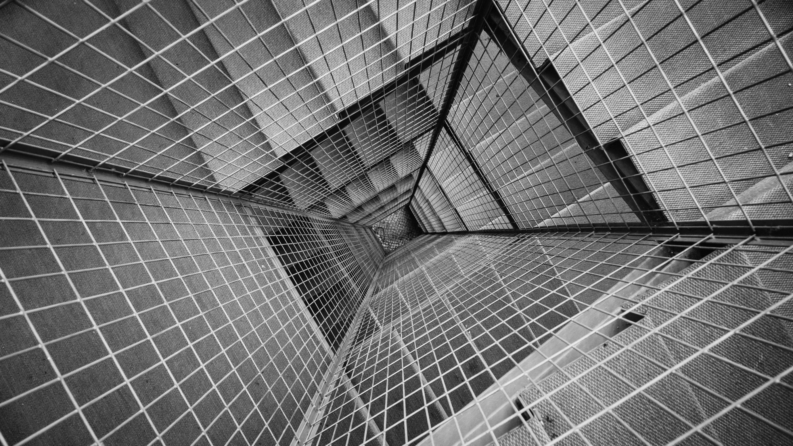
Smart Building : AI & IoT in CRE
Empowering Smart buildings enable productive people
Presented by Team – Data Maniacs
Teja Mukka
SaiPraveen Vabbilisetty
Vikram Gopali
Harkirat Kaur
Lipsa Senapati

Slide 2
Need for Smart Buildings
With Smart Building
Without Smart Building
Improve Occupant Comfort
Enhancing Performance
Enhanced revenue generating services
Deeper focus on end-client experience
Intelligent decision making
Minimal to no manual involvement
Full sustainability program with real-time analytics
Less Flexibility
Higher Maintenance and Operational Costs
Constant Energy Usage
Less user focused experience
Rule based Decision Making
Manual Dependency and Labor Costs
No Real- time Analytics

Slide 3
Smart Building Components
Leveraging IoT data
Predictive Maintenance and fault detection
Predictive Energy Optimization
Anomaly Detection
Smart Asset Management
Smart Space Leasing
Auto Ambience Setting
Air Quality Management
Smart Waste Management
Fire and Security
Medical and Emergency
Fitness and Gym

Slide 4

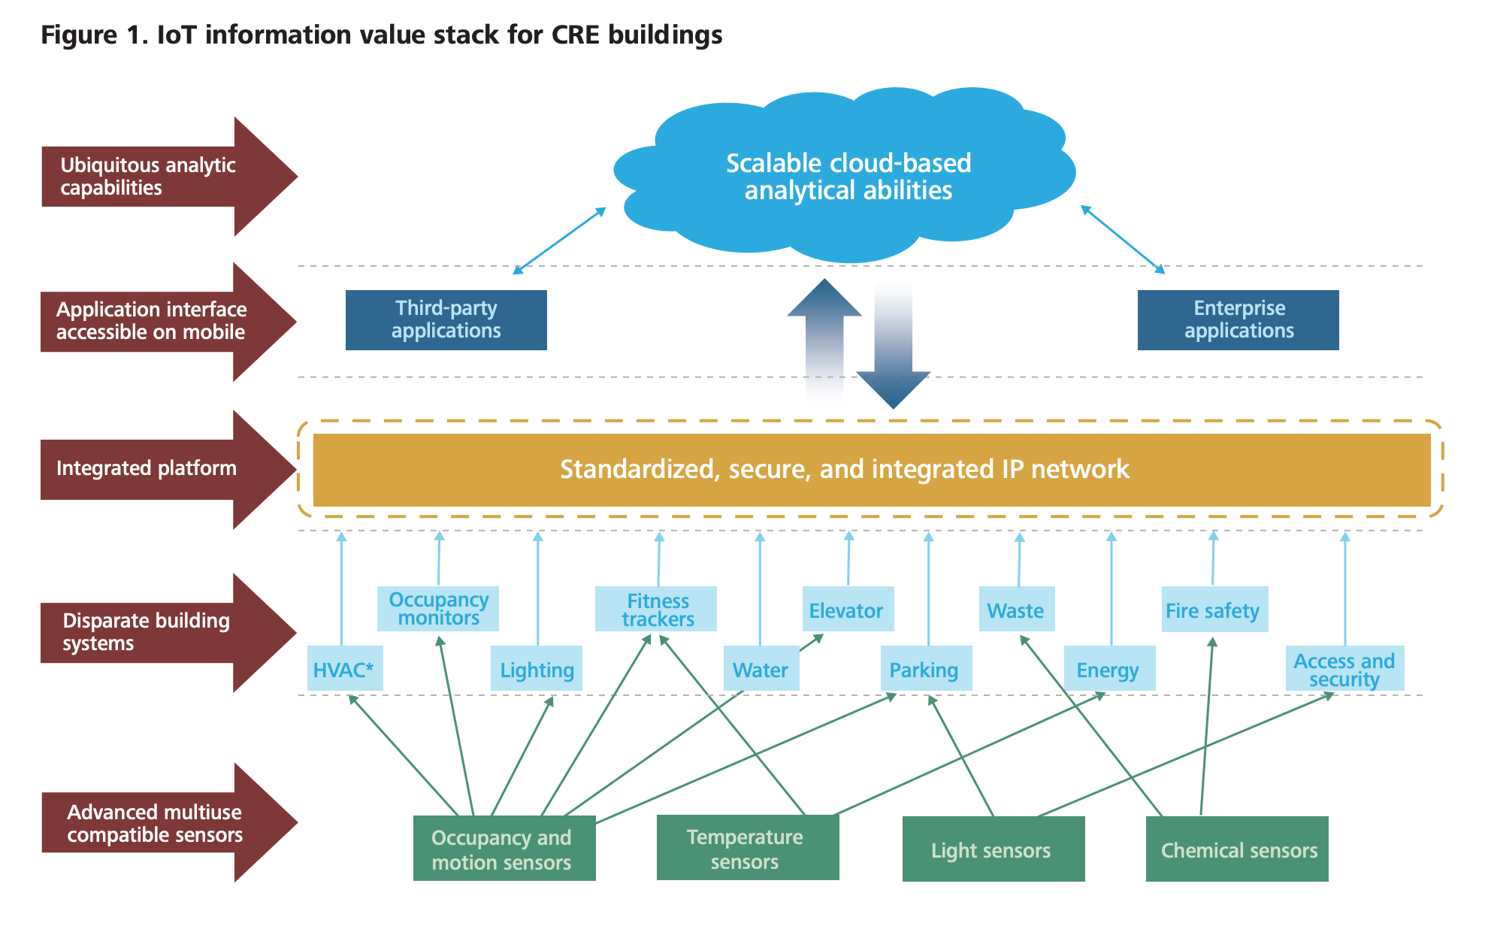
Large Picture Slide
w

Slide 5

Predictive Energy Optimization

Slide 6

Energy optimization
Uses auto-dimmer to auto-adjust the intensity of the light in the room. Hence reducing electricity consumption.
The key significant feature i.e. the inner ambient luminosity is predicted using the outer luminosity and various external factors.
Used multi-linear regression to predict the ideal inner ambient luminosity

Slide 7
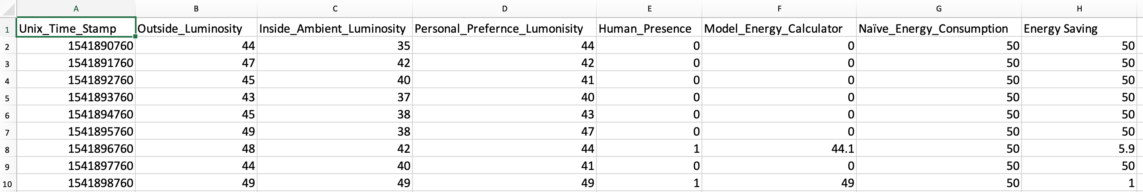
Large Picture Slide
Energy Optimization using Auto Dimmers and Heat Maps

Slide 8
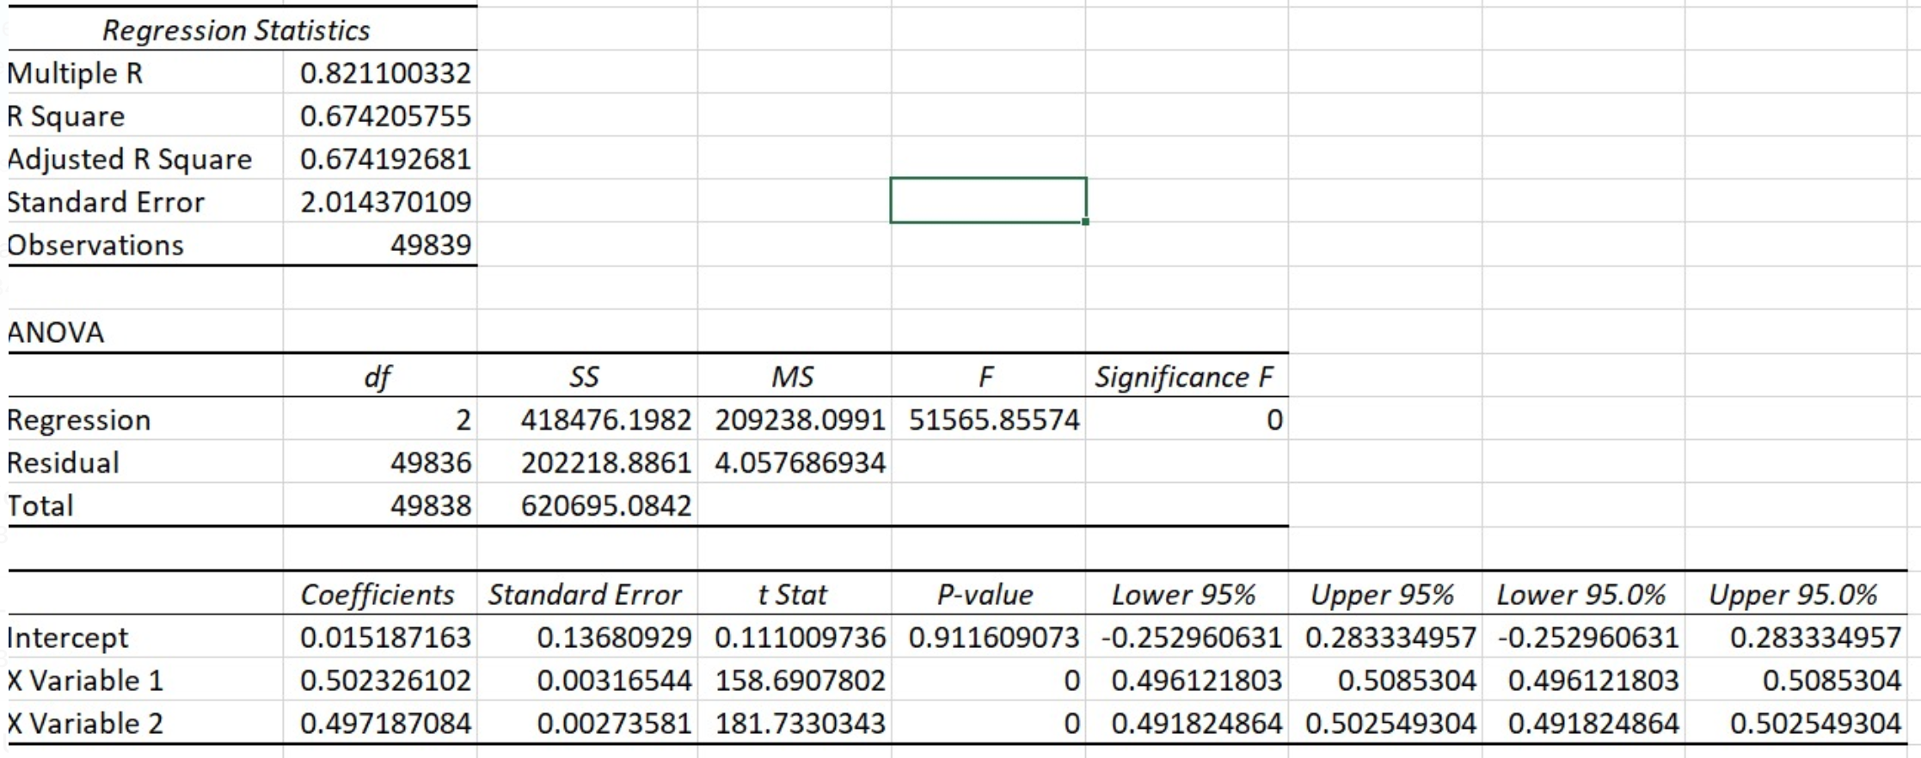
Energy Optimization Results – Auto Dimmer

Slide 9
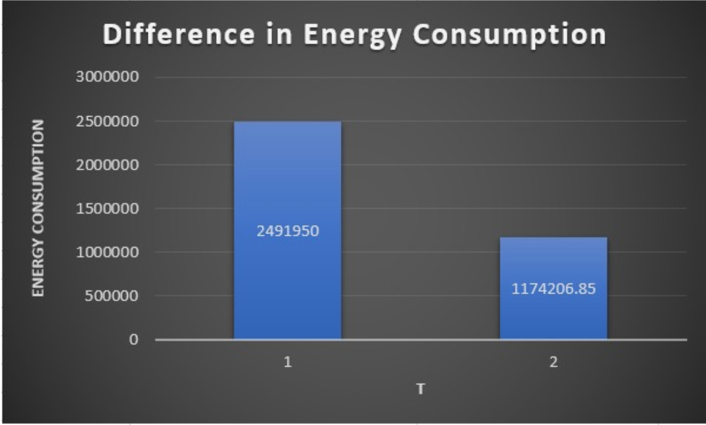
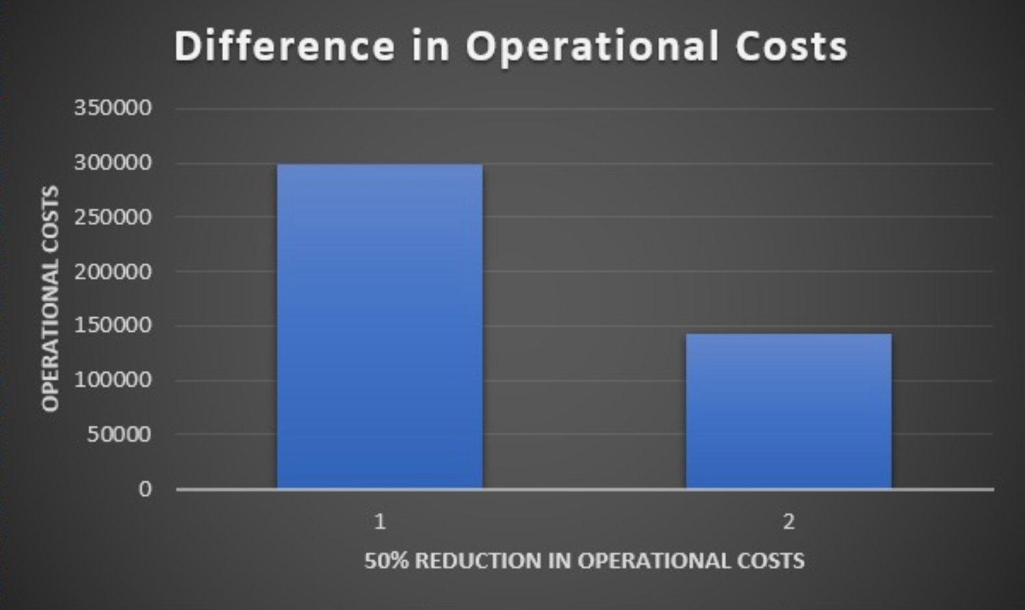
Energy Optimization Results – Auto Dimmer
Total Energy Consumption saved by 50% !!!

Slide 10
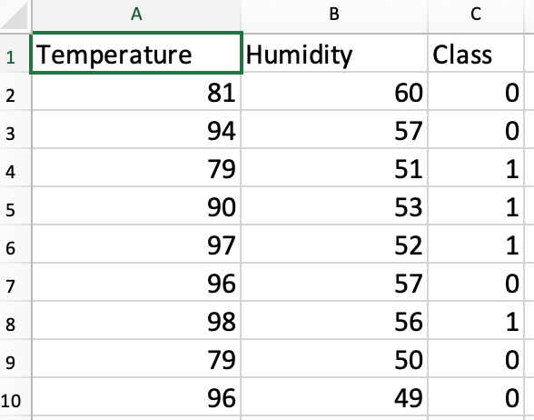
Energy Optimization - Sprinklers
A smart sprinkler controller can regularly regulate and likely to reduce electricity and water consumption.
Humidity data is gathered from weather API using zip code as key attribute
Water and Electricity Consumption saved by 26.66% !!!

Slide 11
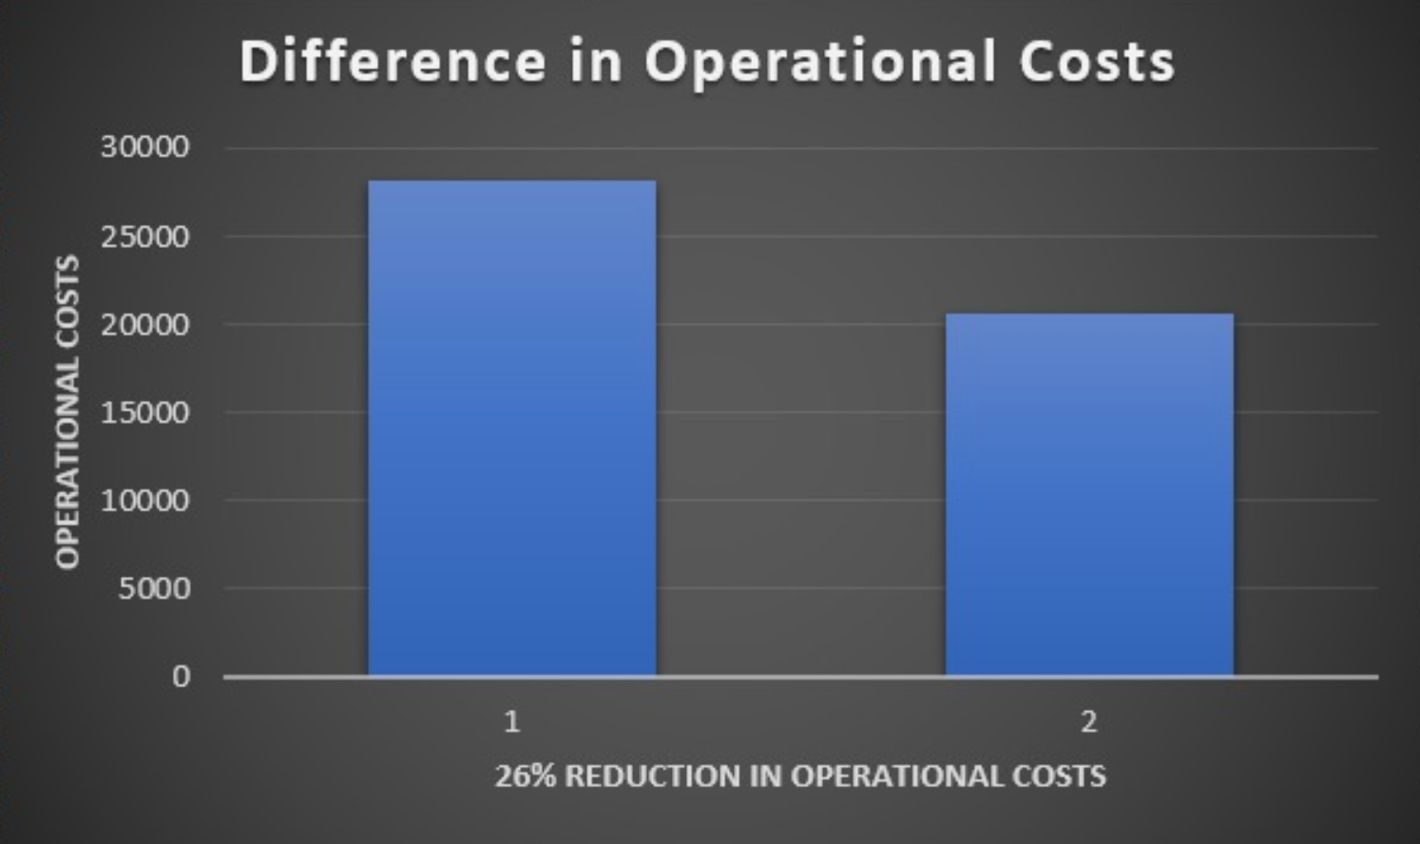
Energy Optimization Results- Sprinklers
Using traditional concepts of logistic regression classified which day of the month needs sprinkler system.
With the use of IOT sensors it detects the humidity of the soil.
If the sensor finds humidity level to be lower than the required humidity level the sprinklers gets activated.
This prevents daily use of sprinklers during monsoons when it is not needed.
Accuracy is 0.7.
Confusion matrix:
 | Predicted No | Predicted Yes
Actual No | 7100 | 2200
Actual Yes | 3300 | 9000

Slide 12
Predictive Maintenance and Fault Detection

Slide 13
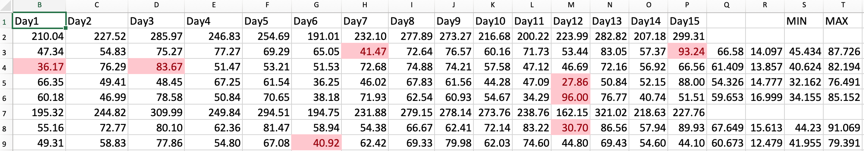
Energy Optimization – Anomaly Detection
Wastage of energy occurs due to delay in detecting faults in electrical appliances like refrigerators
Using statistical analysis, most of the legit data falls within 1.5 standard deviation from the mean
The earlier the prediction, the lower is the consumption rate.

Slide 14
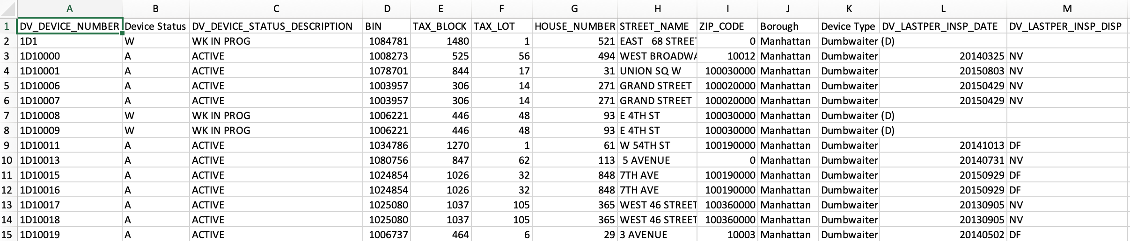
Energy Optimization - Elevator
Predictive maintenance makes use of IOT sensors and other hardware devices to get report on the state of equipment.
It predicts the time ‘t’ of when the equipment will fail in the near future.
It gives an estimated time of when the maintenance needs to be performed.
It reduces regular maintenance visits, labor costs and lost production time.

Slide 15
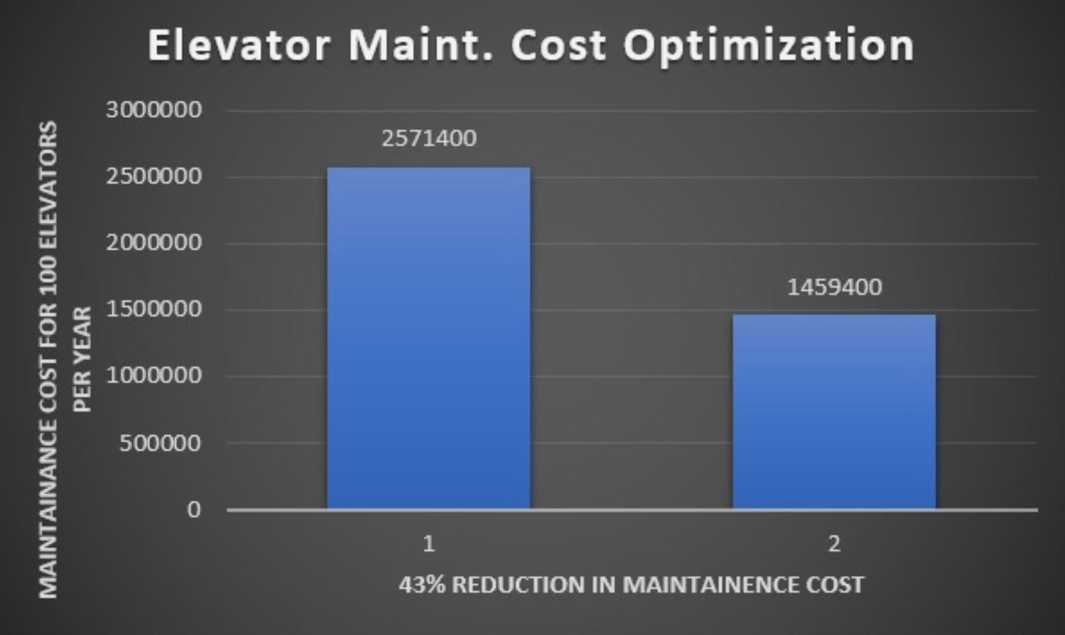
Energy Optimization Results- Elevator
Maintenance cost for 100 elevators for each visit cost $1500 (Usually 15-20 days for a visit)
Monthly maintenance cost per elevator is around $2150 which comes around $25714
Risk prediction is the model that we adopted to predict the repairs/maintenance operations
Developed model clustered based on ZIP Code
ZIP codes with in a cluster have same frequency of failure
This increased the average from 21 days to 37 days which decreased the maintenance cost from $25714 to $14594 per elevator

Slide 16
Improving Tenant Comfort
AI can be used to refine advanced models of how a building performs based on a variety of variables. Using an app or other feedback mechanism for tenant input could potentially be another data stream to improve that model.

Slide 17
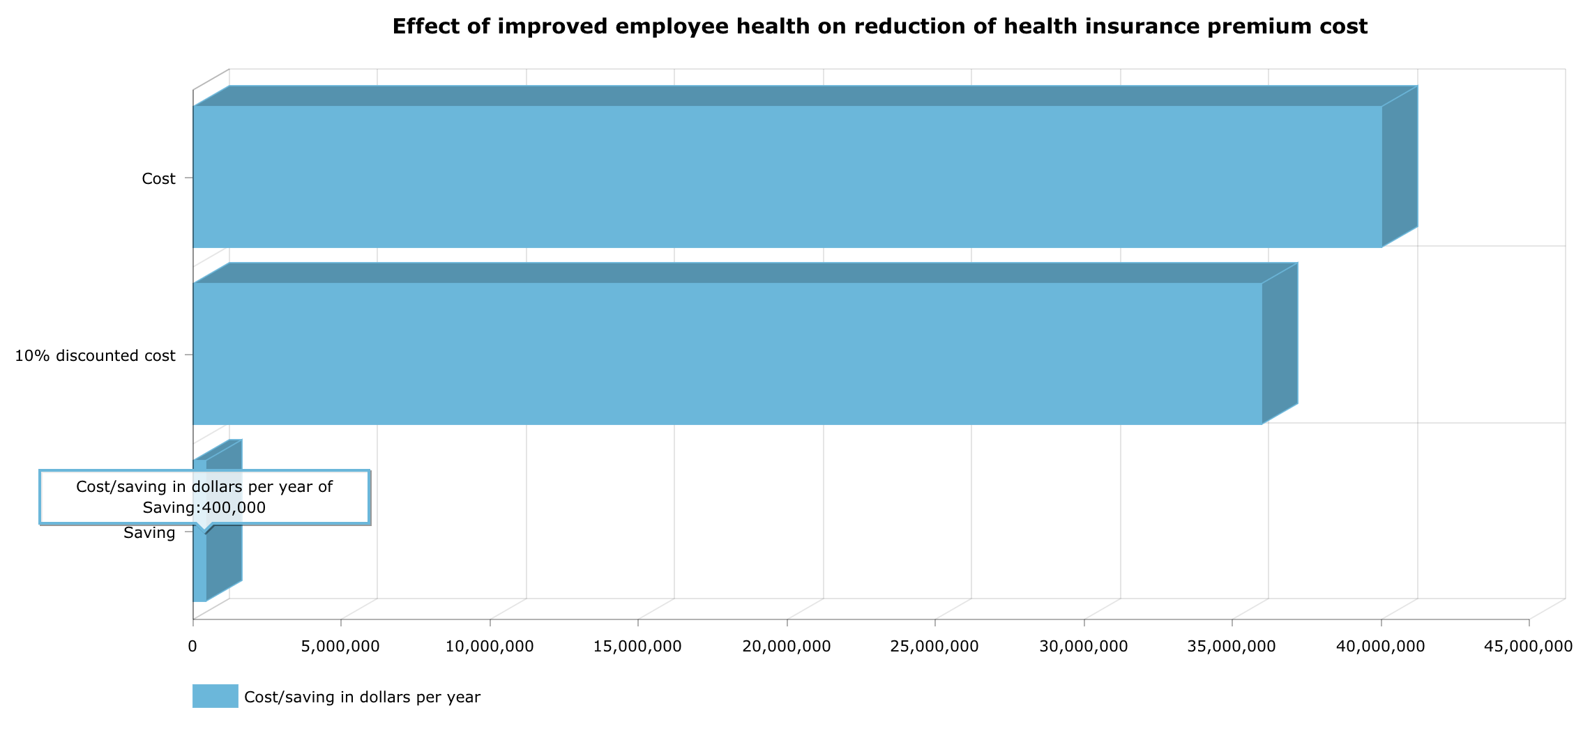
Large Picture Slide

Slide 18
Large Picture Slide
Creating value by Improving Efficiency and bringing about Differentiation

Slide 19
Enhanced building performance
Data collected by motion and occupancy sensors at a building level to regulate air-conditioning and lighting in real time
CRE companies can also offer clear value to tenants, since the system could lead to lower energy bills.
IoT can help reduce the cost of energy, spatial management and building maintenance by up to 30 percent.
Realtime monitoring can bolster internal security, and specialized weather sensors provide advance warnings of adverse weather events.

Slide 20
Better portfolio risk management and liquidity
Enhanced tracking and monitoring at a building and portfolio level, along with use of portfolio analytics, can result in lower asset risk, more granular valuations, and enhanced portfolio management capabilities.
Tracking the flow of people can enable CRE owners to analyse occupant behaviour and space usage patterns, while acknowledging privacy limitations.

Slide 21
Focus on employee and occupant health and productivity
Wearables such as smart glasses can combine IoT technology with augmented reality to provide prompt information and guidance to workers in the field.
Sensors will likely be able to help CRE companies capture data on occupant health—assuming the occupants are amenable.
The buildings’ HVAC and lighting systems can make necessary adjustments in ventilation and space conditioning and provide a healthier environment for occupants.

Slide 22
Service innovation to tenants
Developers can adapt design and construction of CRE buildings to the changing consumption patterns such as combined “live/work/play” by using tenants’ and end-users’ behavioral data.
AirSage, a location-based service provider, collects real-time location data for billions of mobile devices each day.
The company aggregates and analyzes anonymous wireless signaling data to provide insights on movement and flow of traffic and consumer behavior.
This information, combined with socio-demographic information on population and job growth, crime, pollution, noise, and climate patterns, should result in better informed decision making.

Slide 23
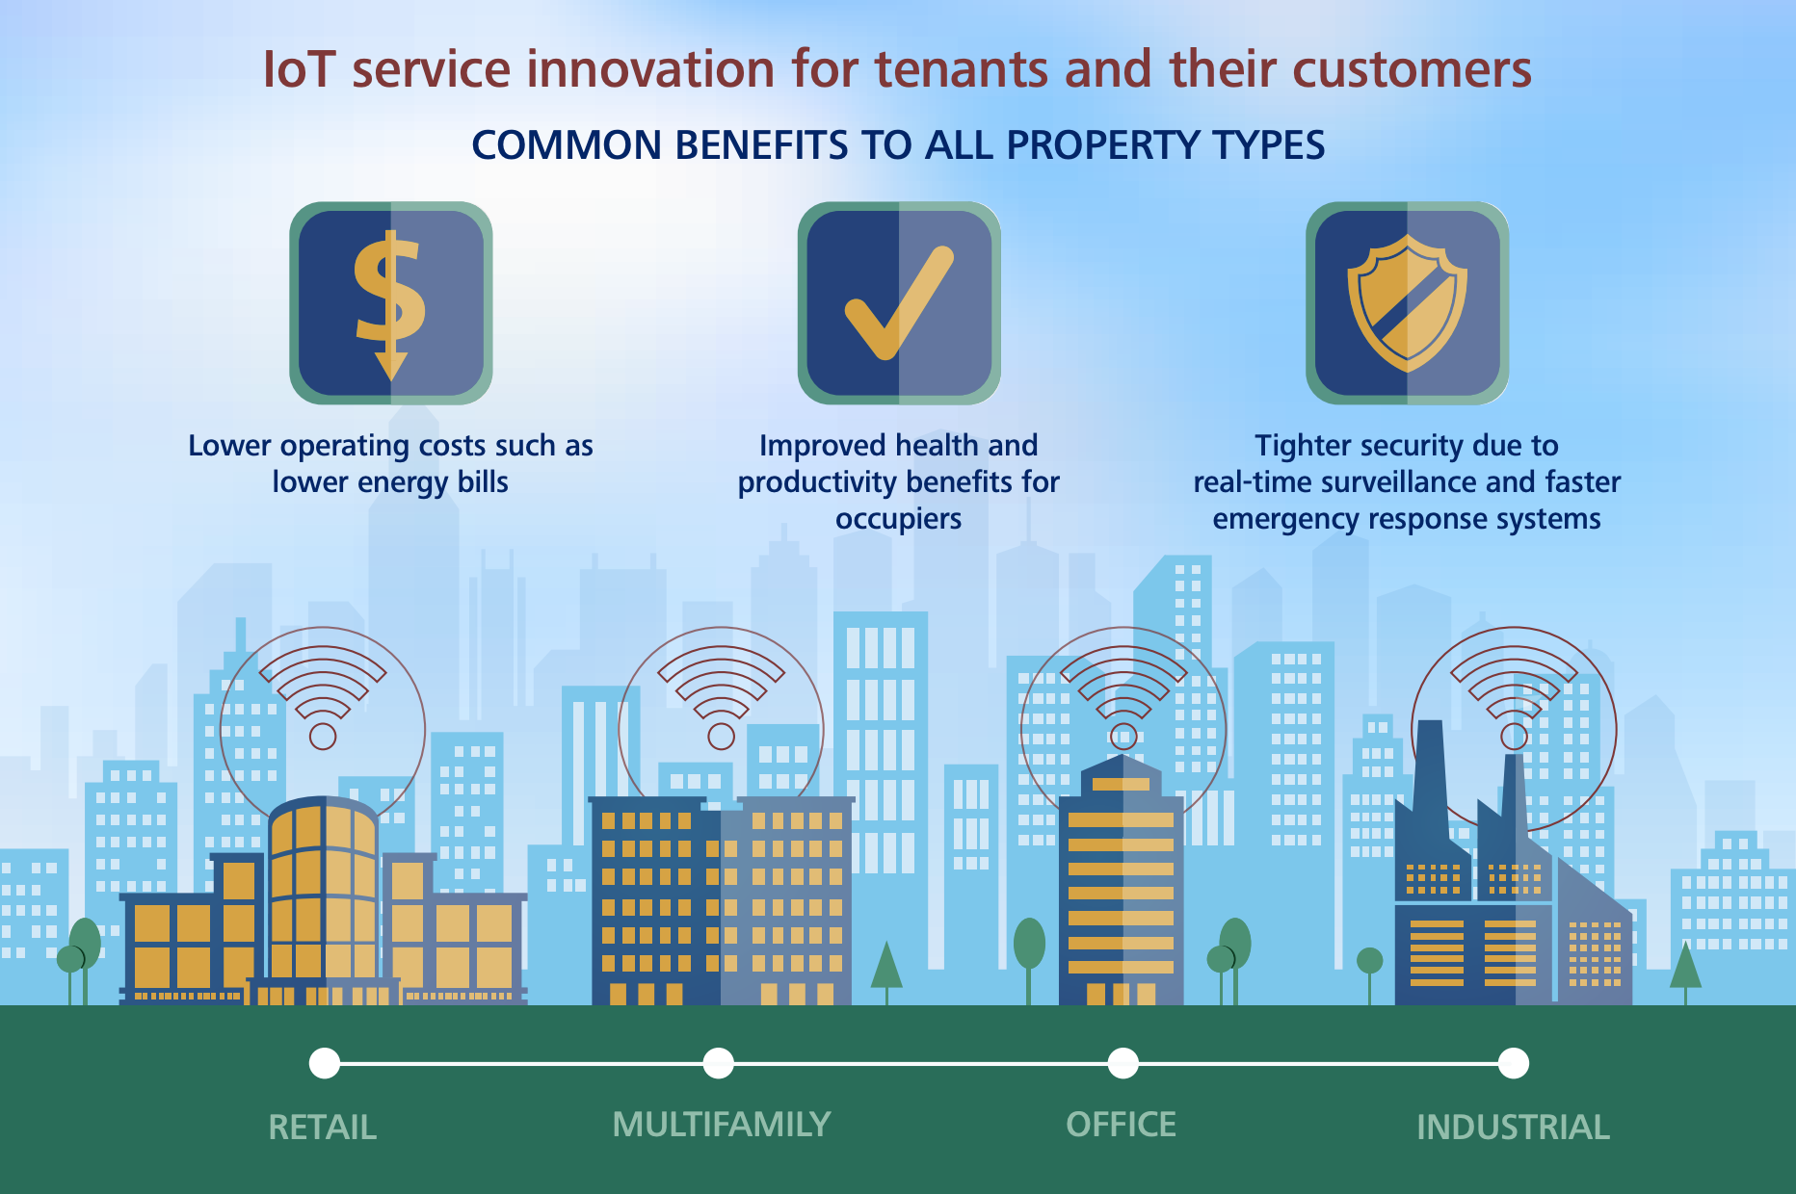
Large Picture Slide

Slide 24
Smart Waste Management
For waste management, sensors in smart trash bins can communicate volumes to help collectors optimize pick-up timings and appropriately plan disposal of different forms of waste.

Slide 25

Cybersecurity and data privacy
Enhanced building performance
The more the number of IoT-enabled devices and the greater the interconnectivity between various building systems, the more detailed and sensitive the data that will be captured. This is likely to broaden the attack surface for hackers, who would have more avenues to cause financial and reputational damage and even loss of human lives.
In reality, 40% of the information in the digital universe requires some level of protection, but only half of that data—just 20 percent—is protected.
So how can we improve???

Slide 26
Cybersecurity and data privacy
Enhanced building performance
Use purpose-built devices or add-ons, rather than pre-IoT solutions.
Develop clear responsibilities for the players in your ecosystem.
Establish a baseline of data
Institute data governance
Create loosely coupled systems

Slide 27
THANK YOU

